Slide 1

Redes neuronales
neural networks
final project year 21

Slide 2

Machine learning platforms

Slide 3
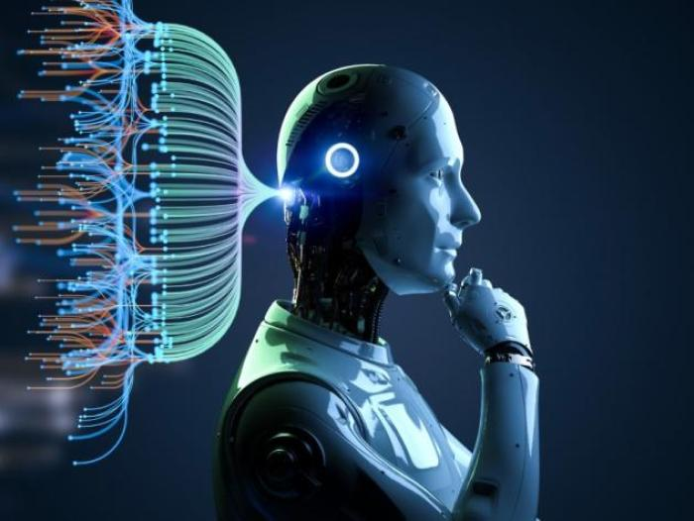
Hardware Development Kits

Slide 4
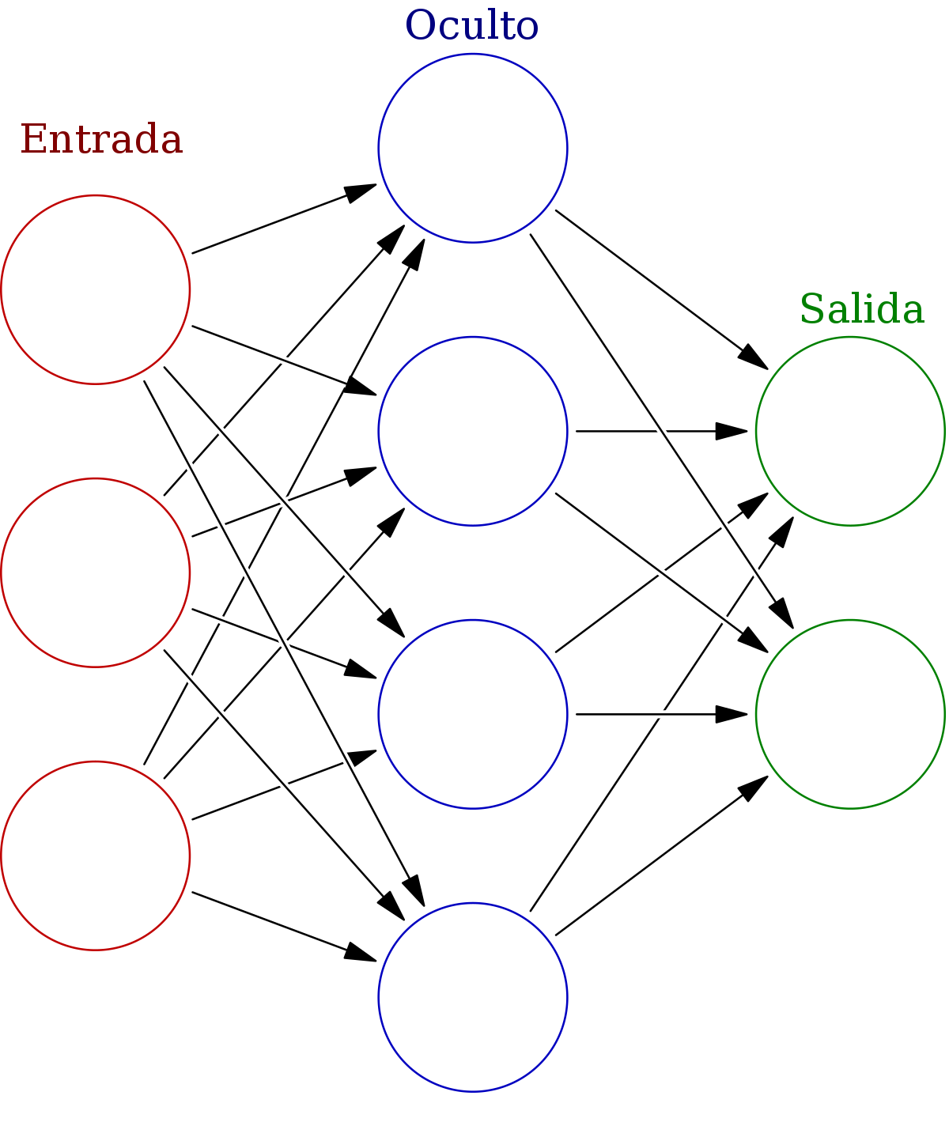
Process automation tools

Slide 5

chatbot applications

